Slide 1
Online store

Slide 2
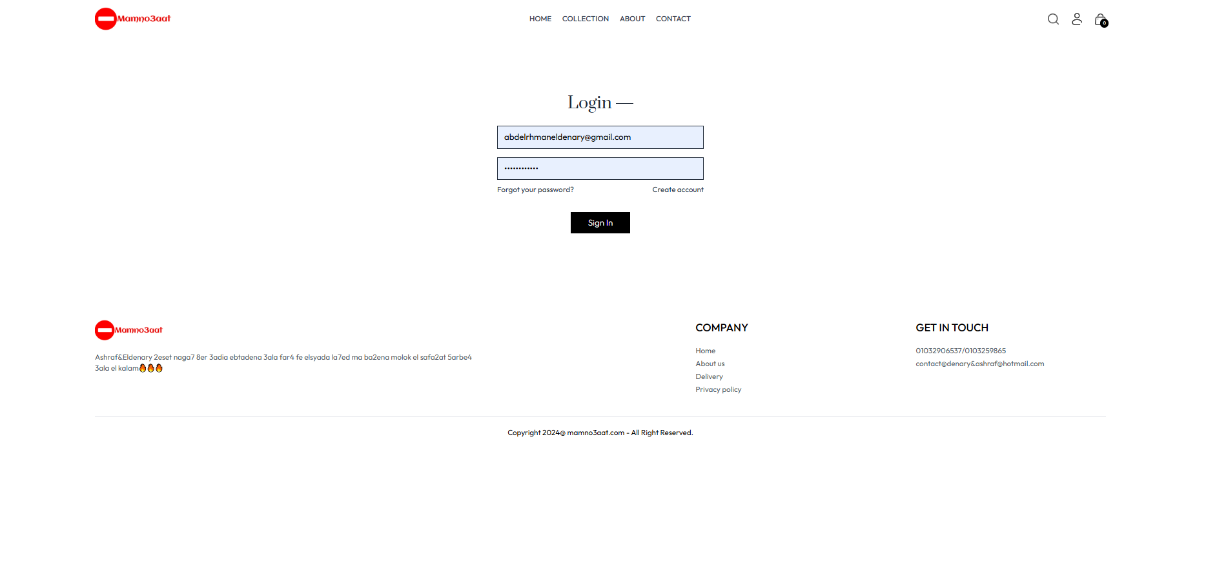
👤 User Profile Management

Slide 3
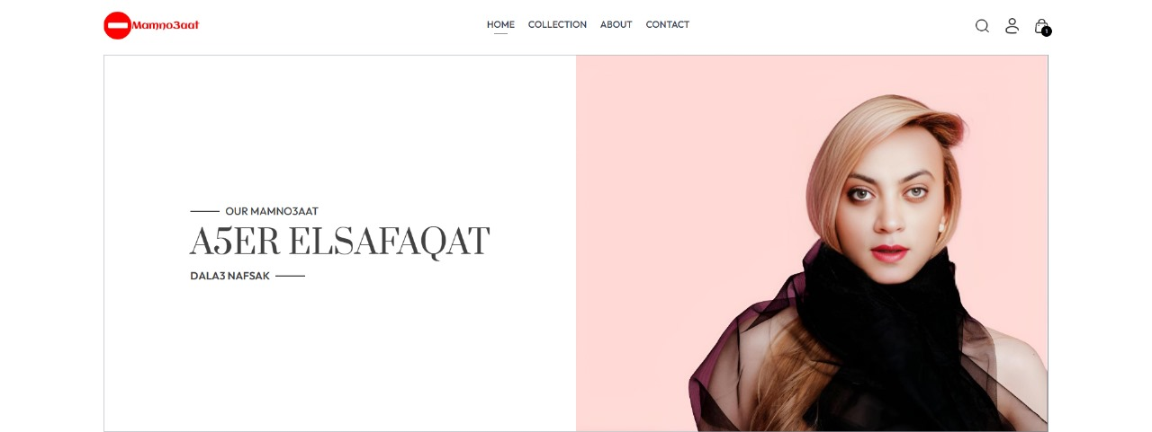
🛠️ Modular and Scalable Architecture

Slide 4
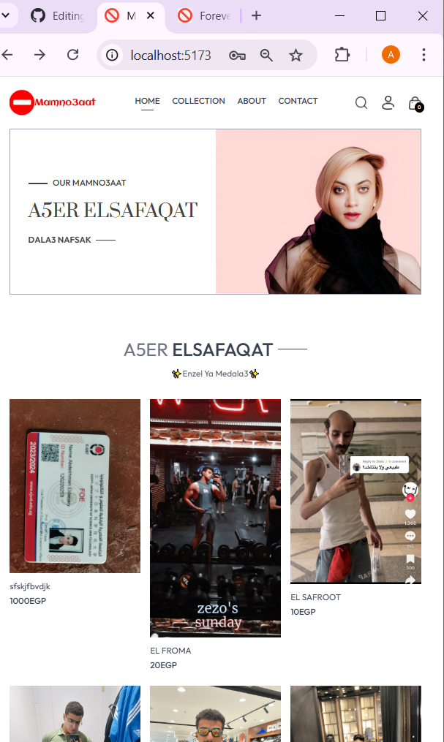
🌐 Responsive Design

Slide 5
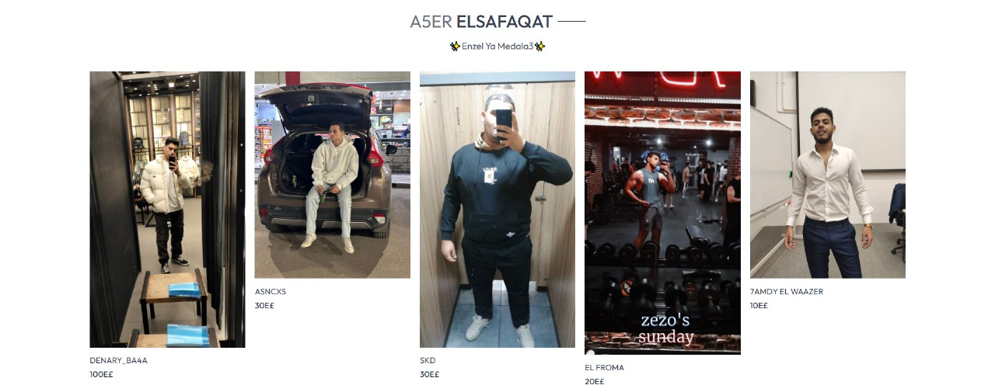
🔥 Bestsellers

Slide 6

Latest Arrivals

Slide 7
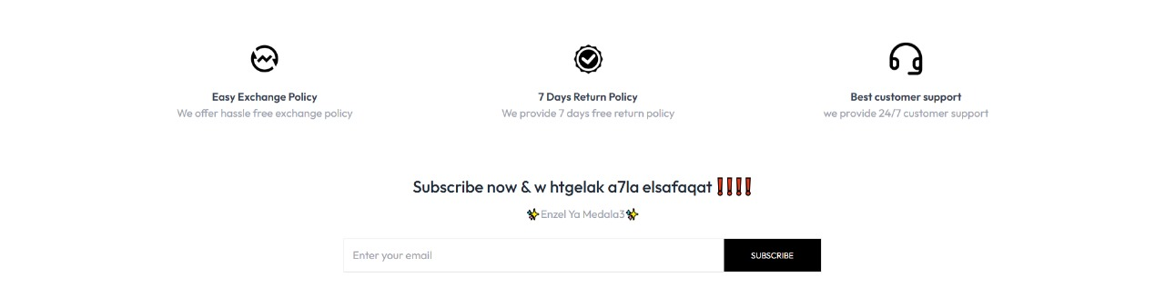
📧 Subscription Feature

Slide 8
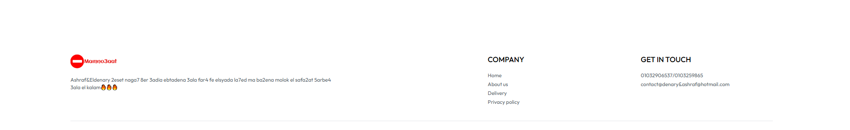
📇 Footer Information

Slide 9
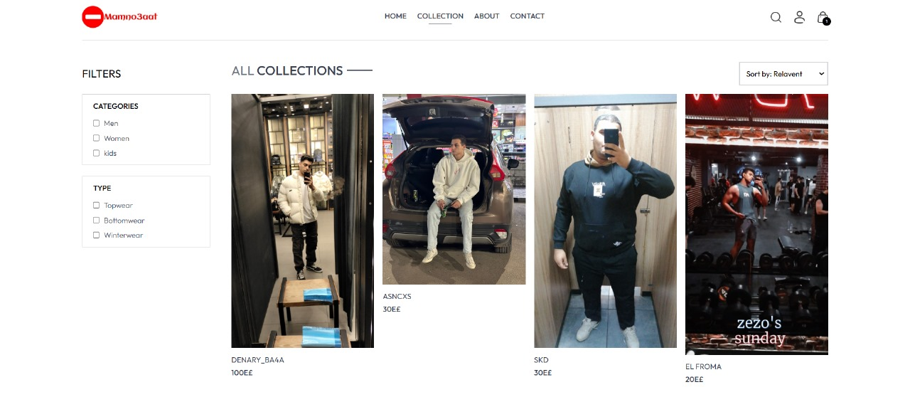
🛍️ Product Catalog

Slide 10
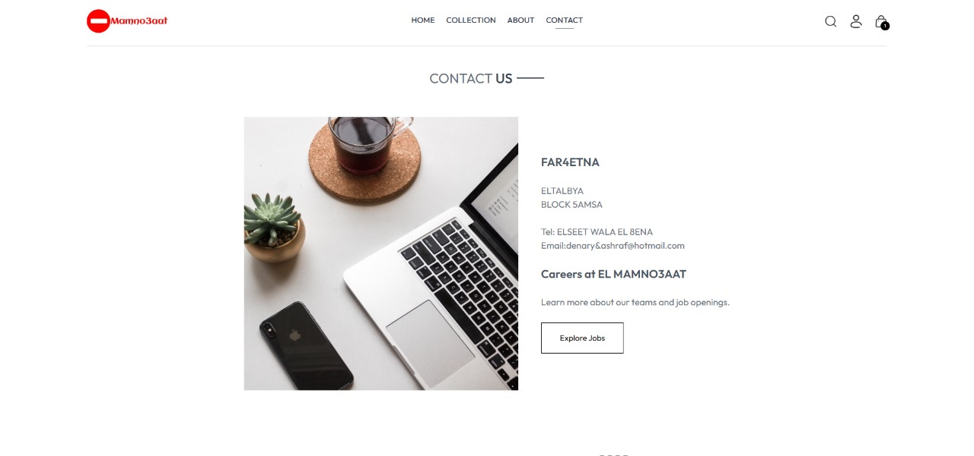
🔗 Social Media Integration

Slide 11
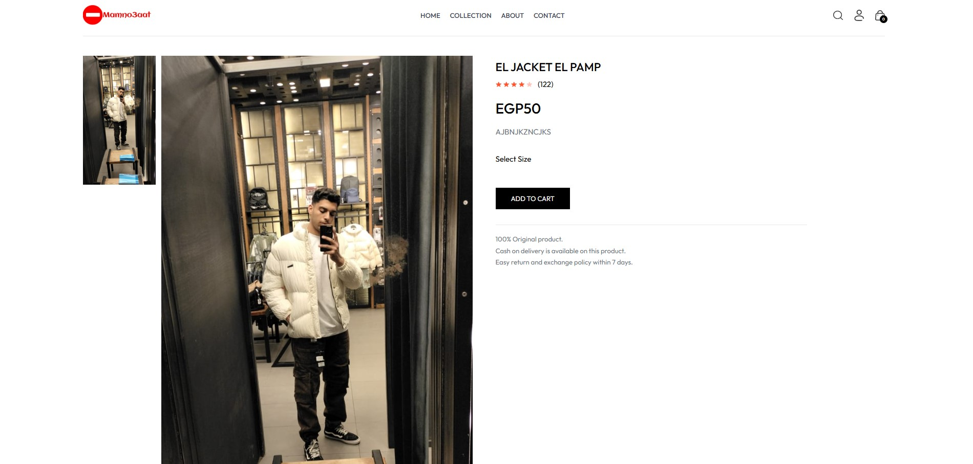
🛒 Order Management

Slide 12
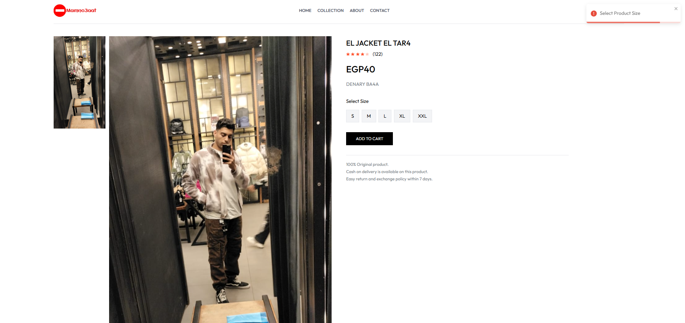
🛡️ Error Handling

Slide 13
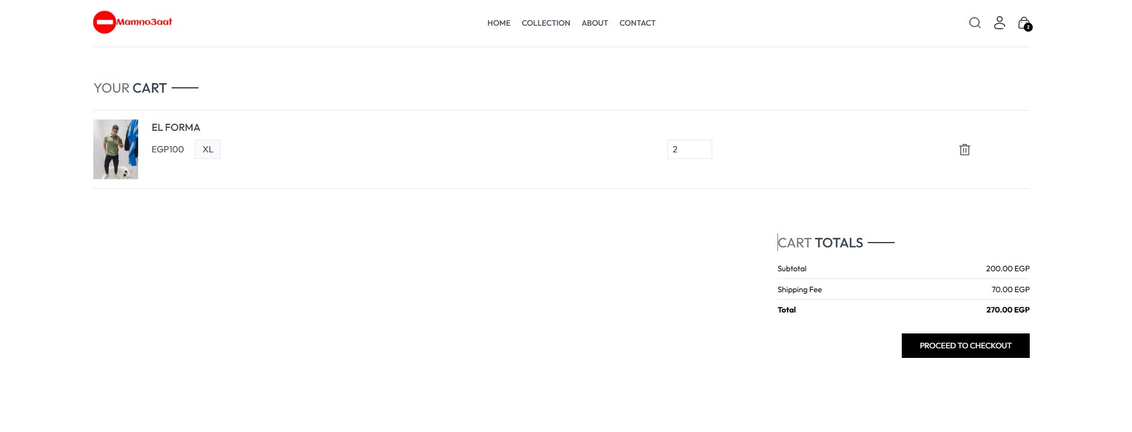
🛒 Cart Management

Slide 14
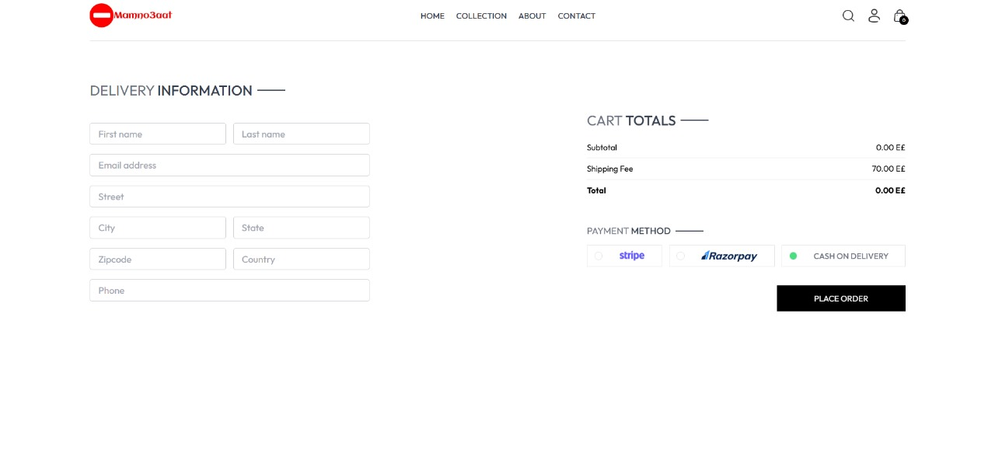
🛒 Order Management

Slide 15
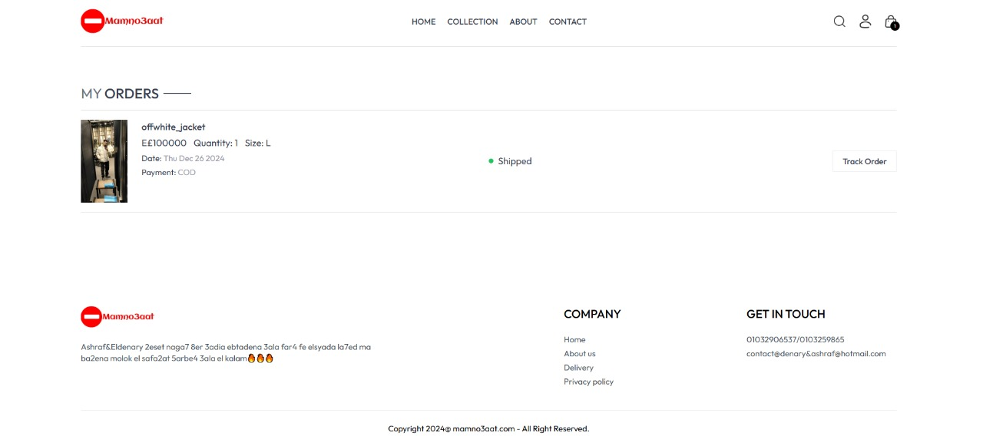
📜 Order Tracking

Slide 16
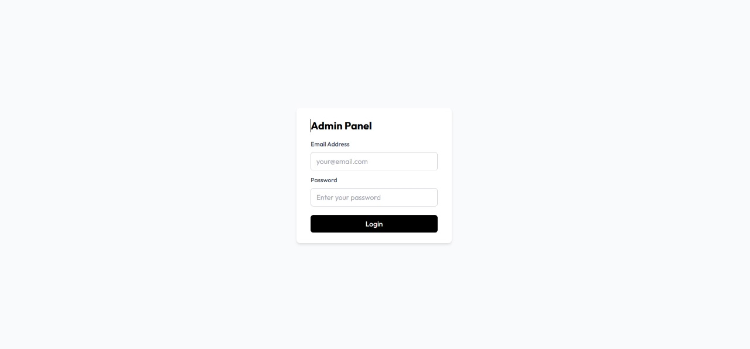
🛡️ Authentication and Authorization

Slide 17
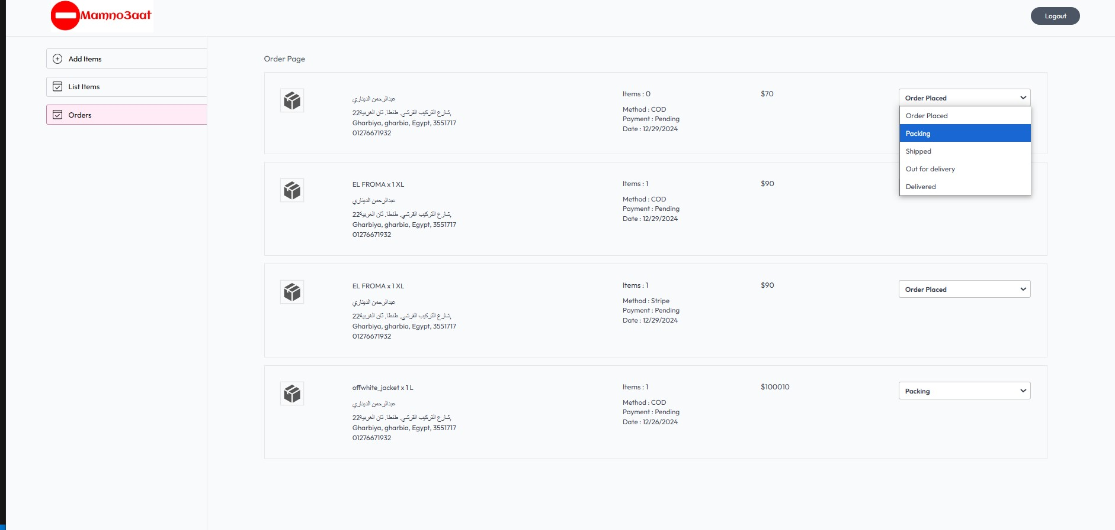
📦 Product Management

Slide 18
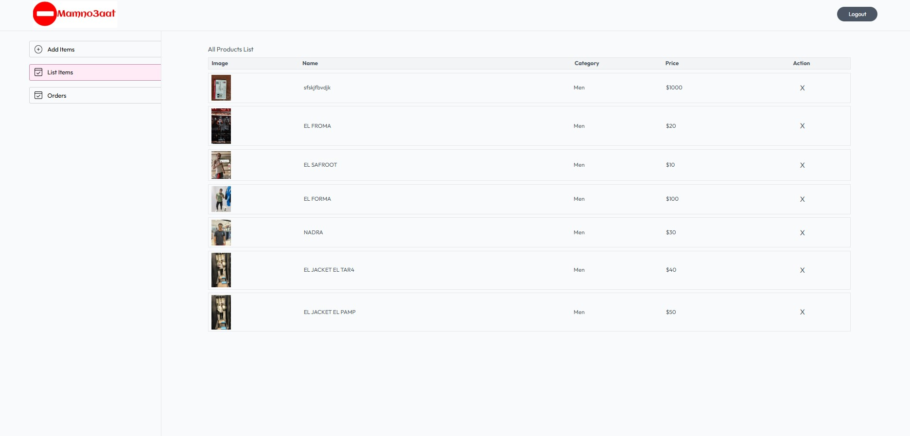
🛠️ Admin Panel

Slide 19
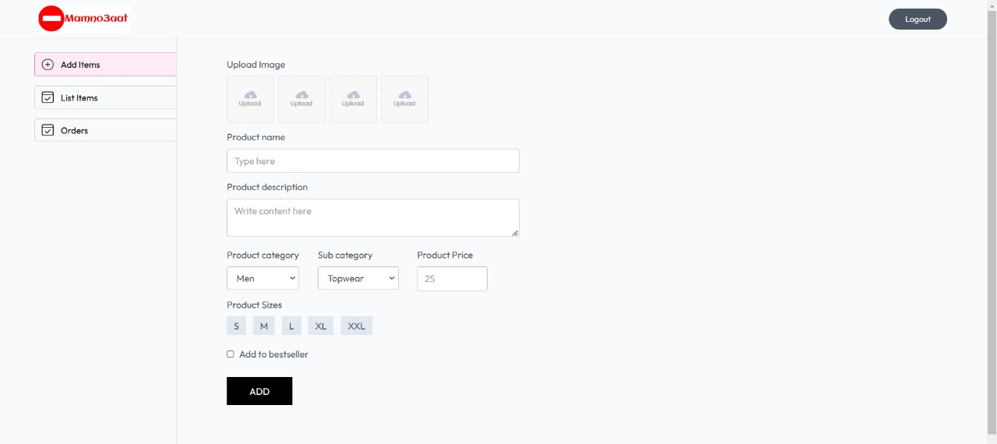
📤 File Upload Support

Slide 20
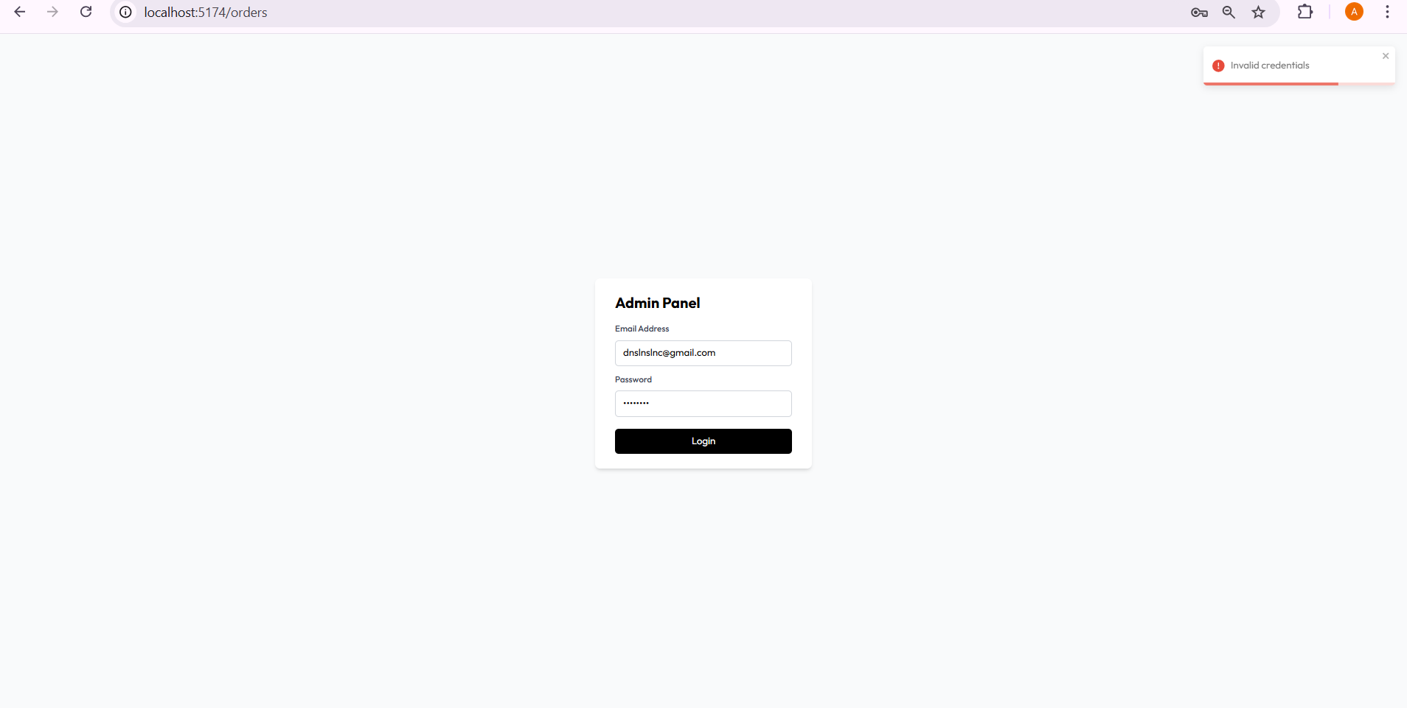
🛡️ Authentication and Authorization

